Slide 1
Updates to Pathways Overview
Eva Tweedy, DTM

Slide 2
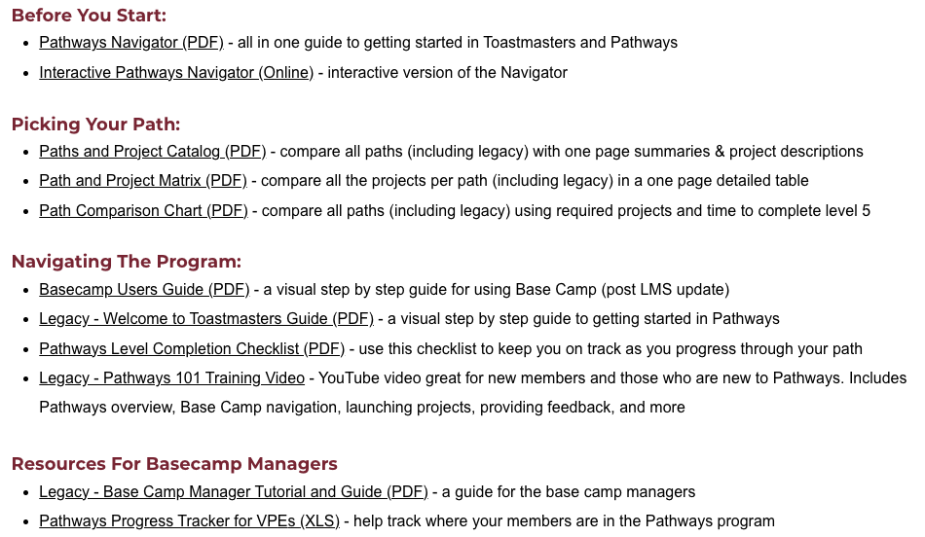
TMD55.org Pathways Resources

Slide 3
11 Paths (Legacy)

Slide 4
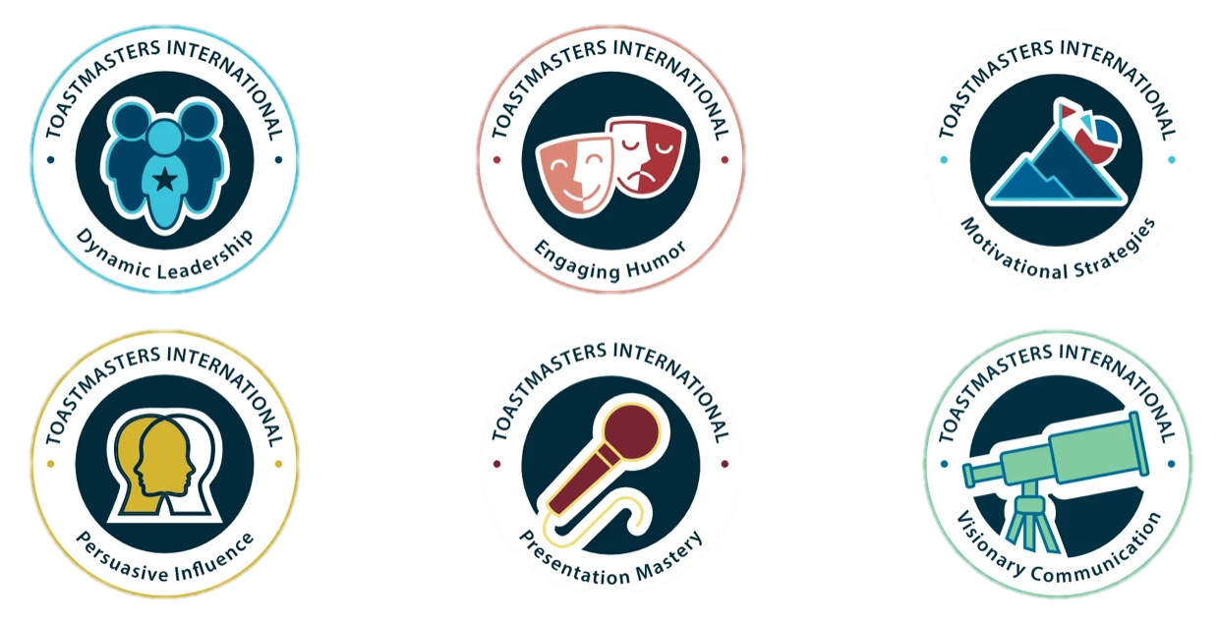
Updated Pathways (simplified to 6 paths)

Slide 5
6 Paths
The primary core competencies represented in each path are listed in order of emphasis below.
Notes:
upcoming Pathways changes [emails.toastmasters.org]. You may remember that in March we announced that Base Camp, the online system where Pathways is accessed, is moving to a new learning management system (LMS) early next year.
The new LMS will launch with six paths:
Dynamic Leadership
Engaging Humor
Motivational Strategies
Presentation Mastery
Persuasive Influence
Visionary Communication
If you start a different path before the new LMS launches next year, you will still be able to access your educational content, complete projects, and receive credit for path and level completions. The content simply won’t look like updated Pathways content.

Slide 6
11 Paths
6 Paths
The primary core competencies represented in each path are listed in order of emphasis below.
Pathways Mentoring Program
Notes:
upcoming Pathways changes [emails.toastmasters.org]. You may remember that in March we announced that Base Camp, the online system where Pathways is accessed, is moving to a new learning management system (LMS) early next year.
The new LMS will launch with six paths:
Dynamic Leadership
Engaging Humor
Motivational Strategies
Presentation Mastery
Persuasive Influence
Visionary Communication
If you start a different path before the new LMS launches next year, you will still be able to access your educational content, complete projects, and receive credit for path and level completions. The content simply won’t look like updated Pathways content.

Slide 7
Levels and Projects

Slide 8
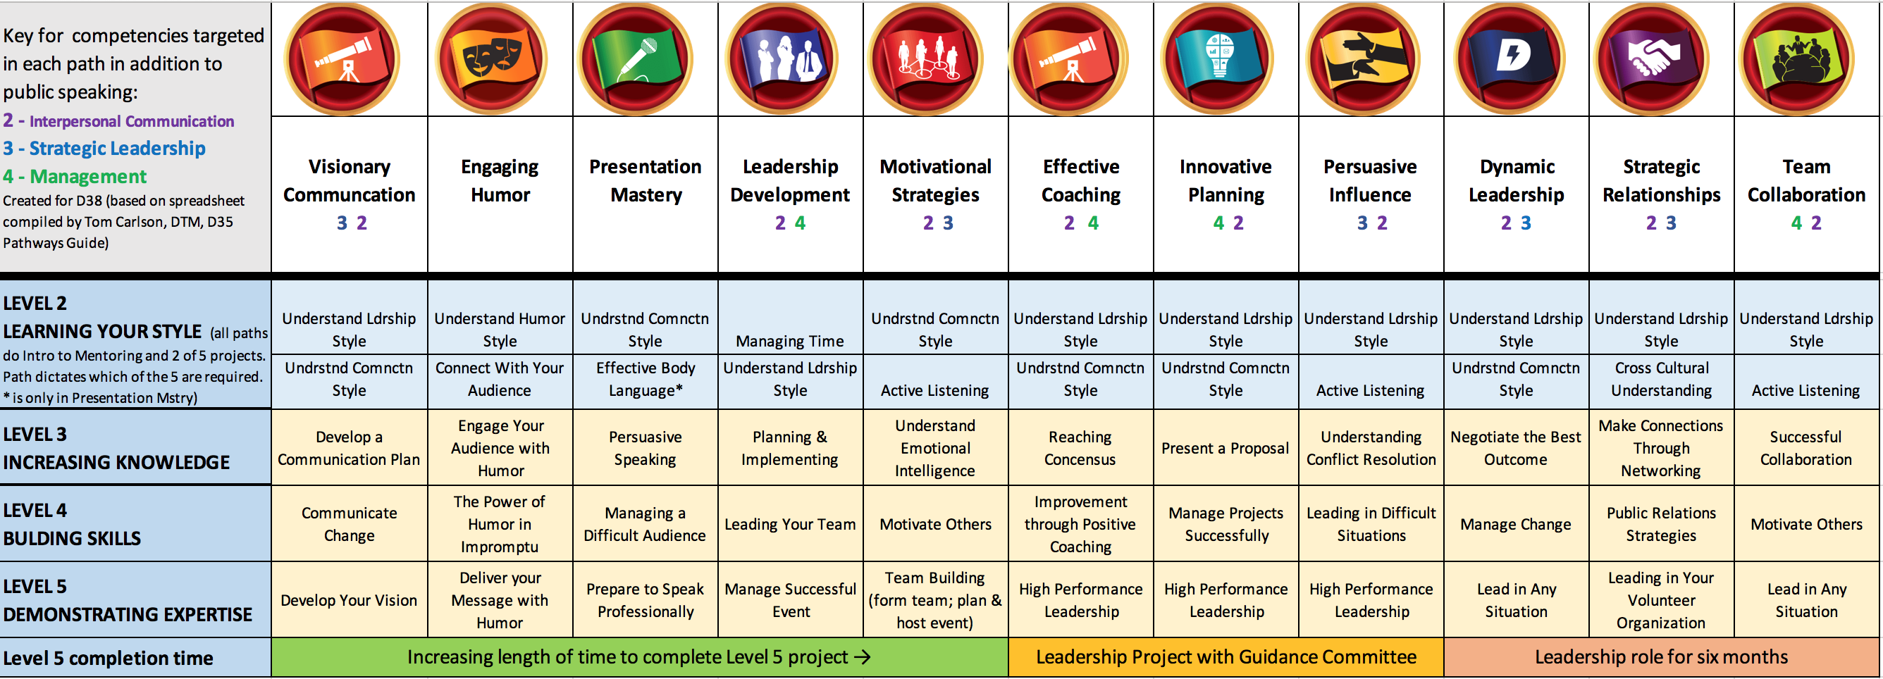
Picking a Path – Using the Chart
Created by D35 Tom Carlson, DTM

Slide 9
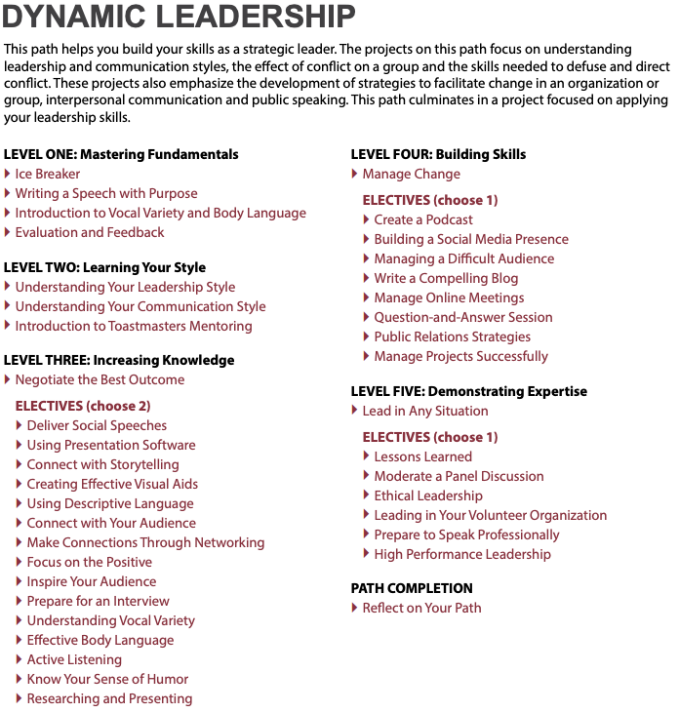
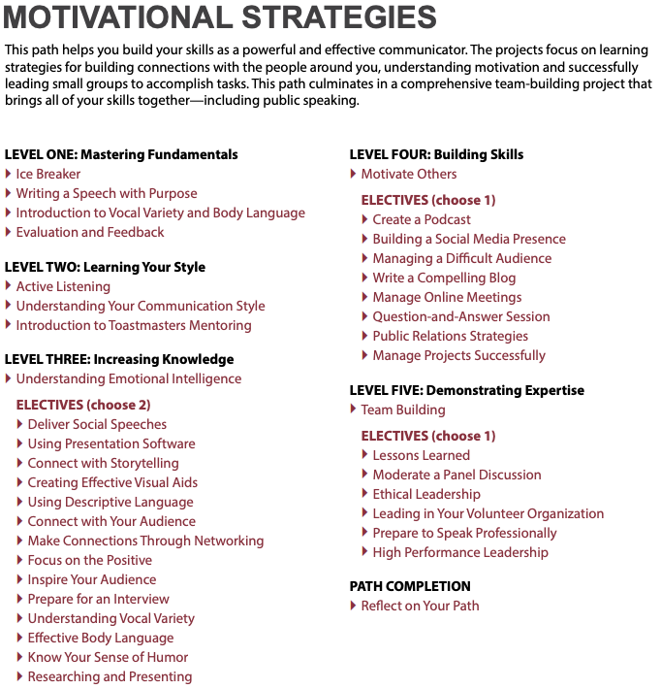
Picking a Path – Using the Catalog
Link to Catalog
VS

Slide 10
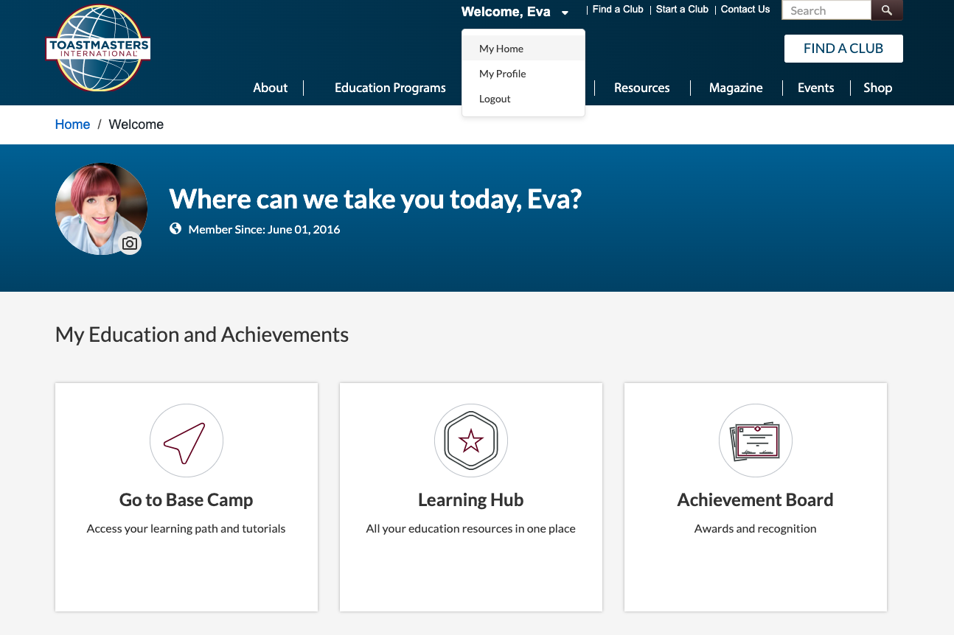
Getting to Base Camp
Go to https://www.toastmasters.org.
If this is the first time you are logging in, click forgot password, and enter the email you put on your Toastmasters application then create a password
Once you are logged in, click on the the drop down by your name and select My Home and click on Go to Base Camp.

Slide 11
What’s New
All officers are now Base Camp Managers
Once levels are complete (in order) and approved in Base Camp by Base Camp Managers, it automatically is submitted in Club Central (even for legacy paths)!
Online evaluation form requests/submissions & Speech Logs*
Explorations (mini focused paths of 3 projects each) coming soon
Inclusive Leadership - unconscious bias, cultural intelligence, & nurturing supportive relationships
Presenting Yourself Online - look and sound your best online, manage online meetings, & conduct hybrid meetings

Slide 12
Differences Between Updated and Legacy Paths
Updated Paths
Legacy Paths
Easy to see and understand side navigation
Complete Projects by clicking on a button
Speech Logs to help keep track of progress
All navigation per project is done in the middle square
Must complete “Assess Your Skills – After” to complete project
No built in Speech Log

Slide 13
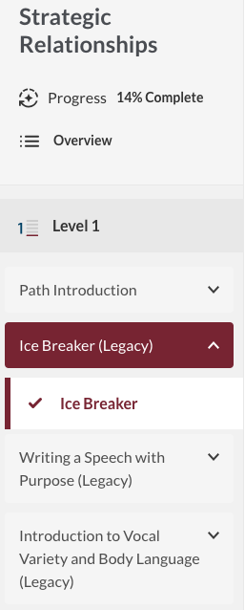
Differences Between Updated and Legacy Paths
Updated
Legacy

Slide 14
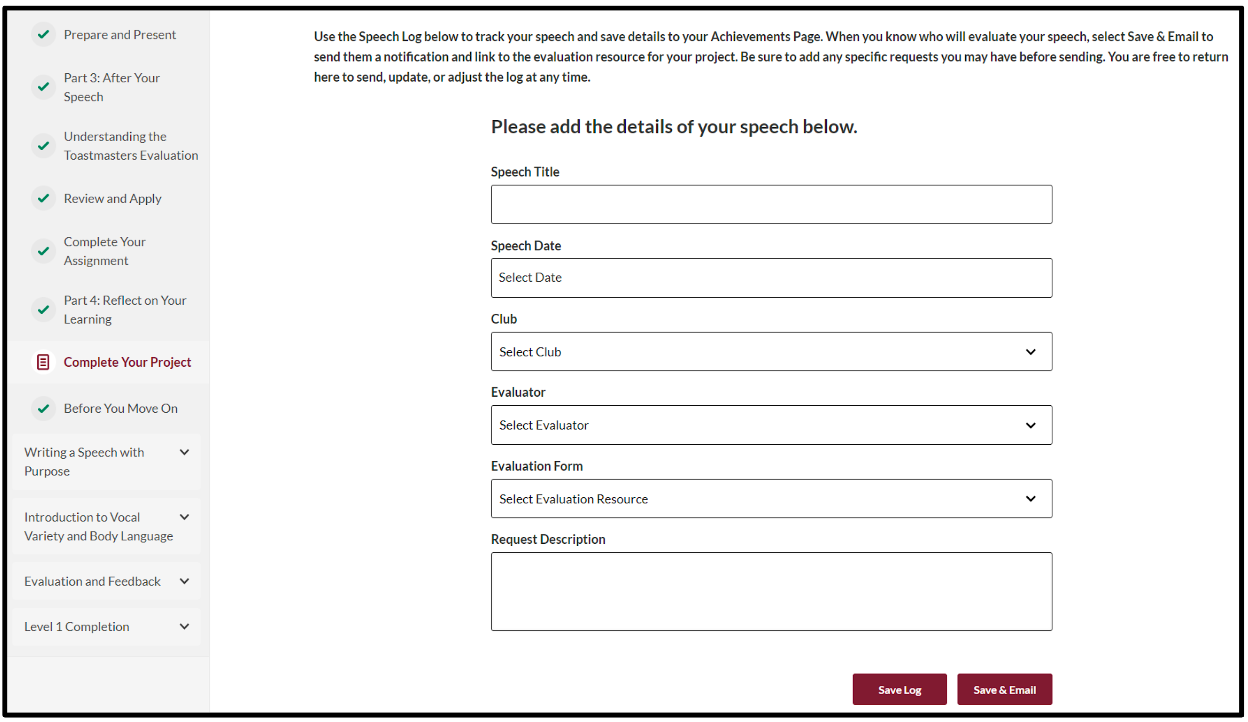
Completing a Speech Log – Within the Project

Slide 15
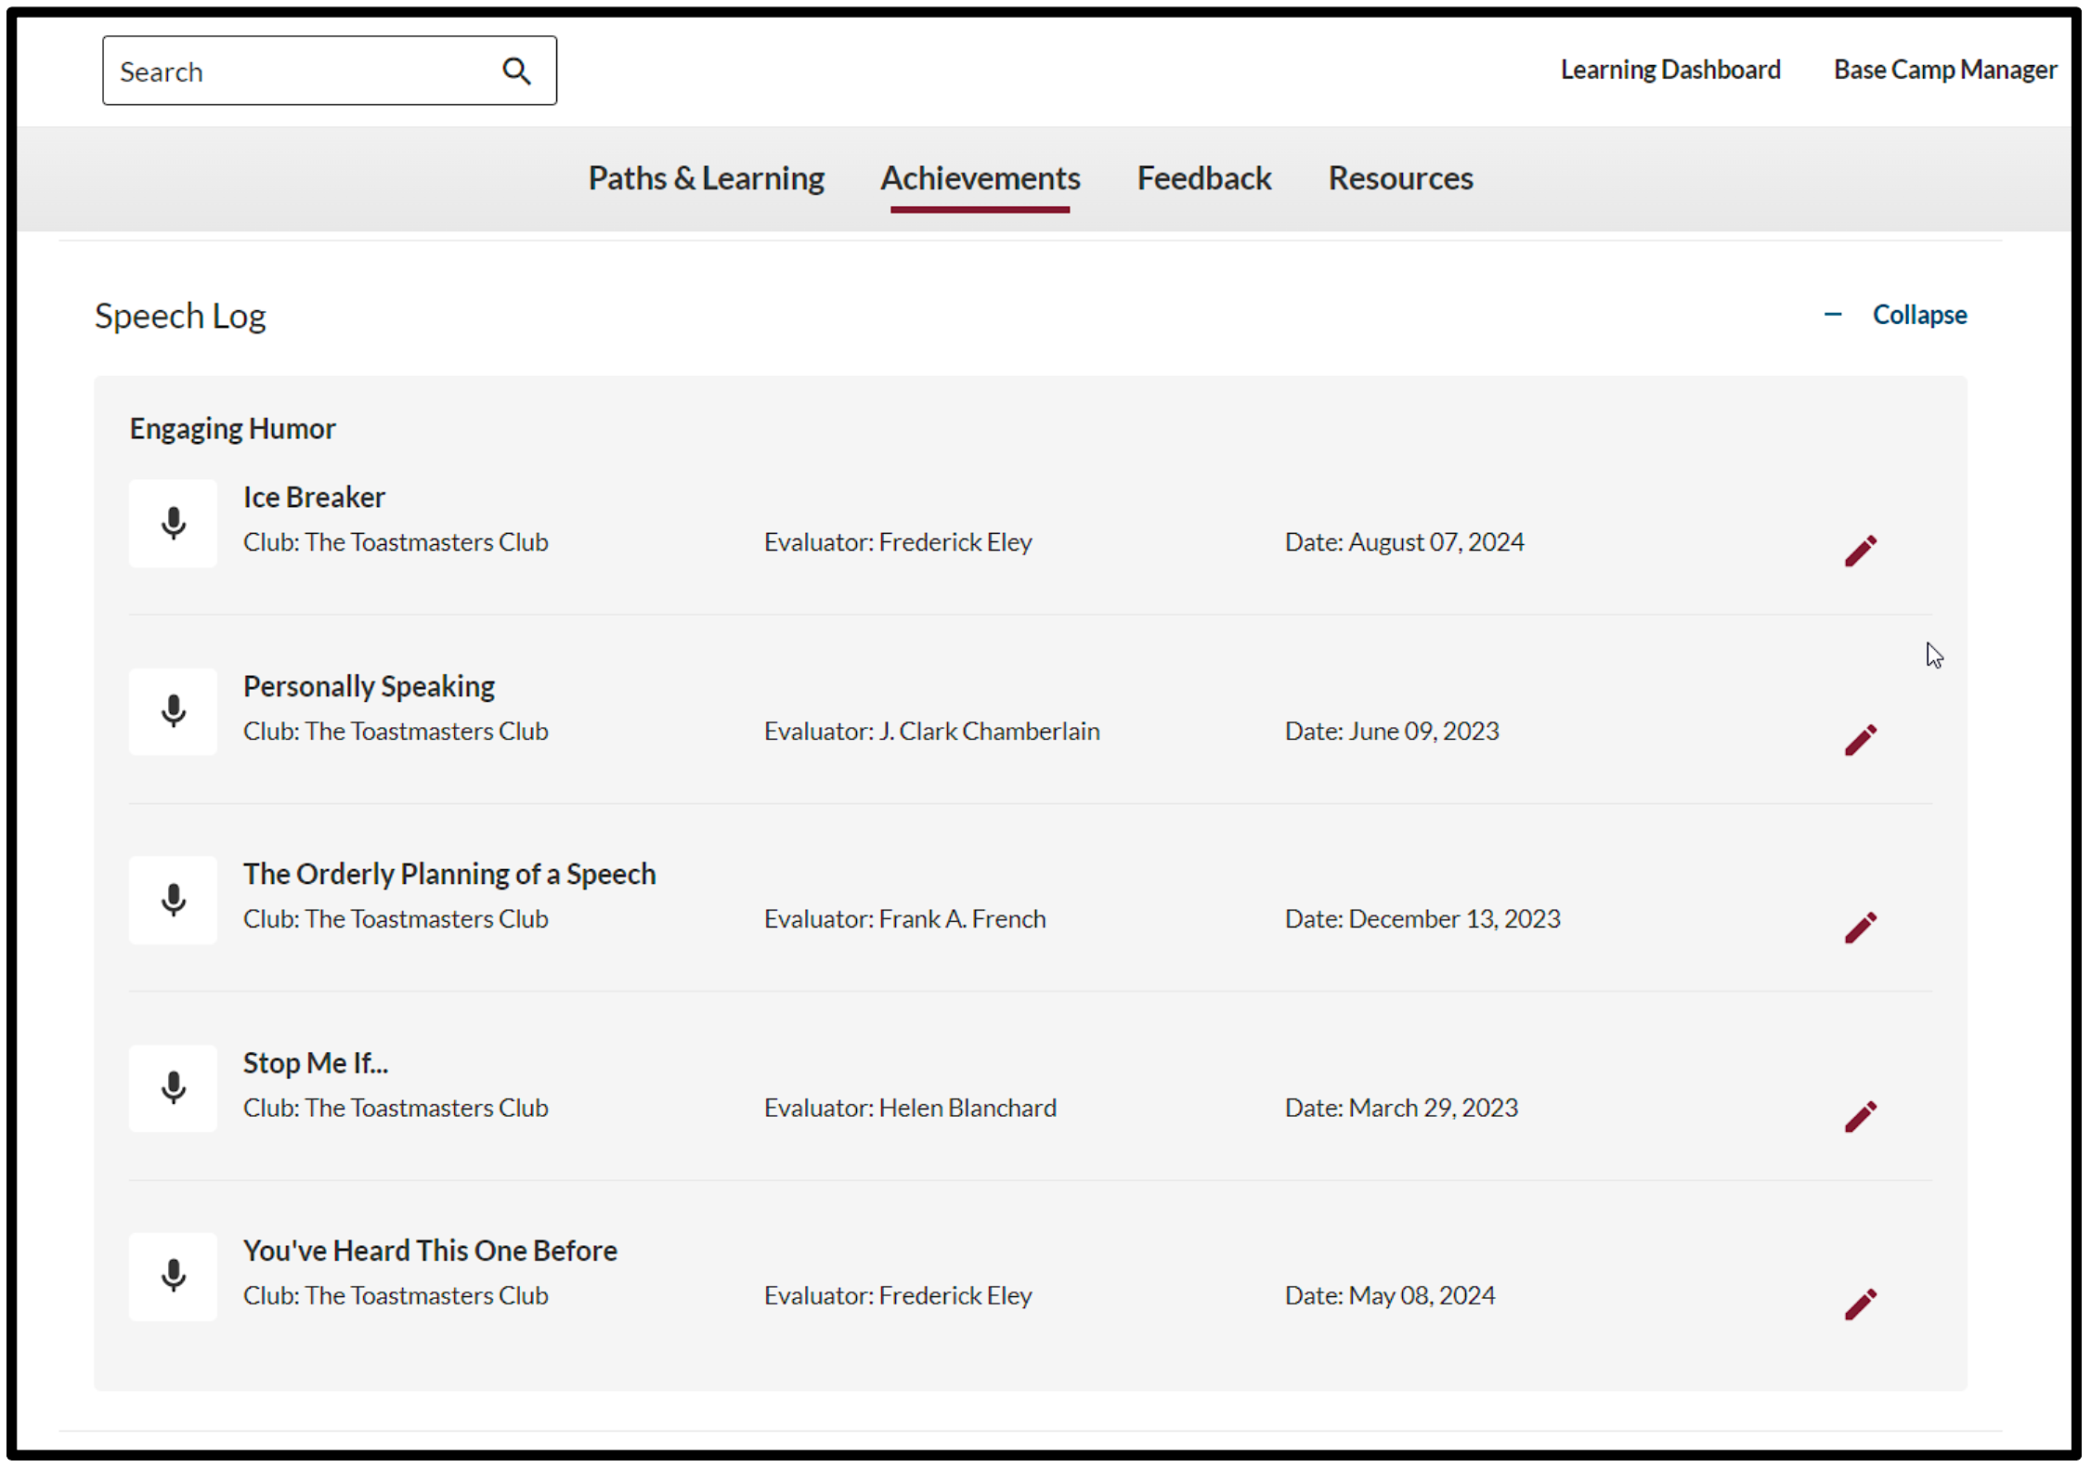
Speech Log

Slide 16
Evaluations – Requesting via Speech Log

Slide 17
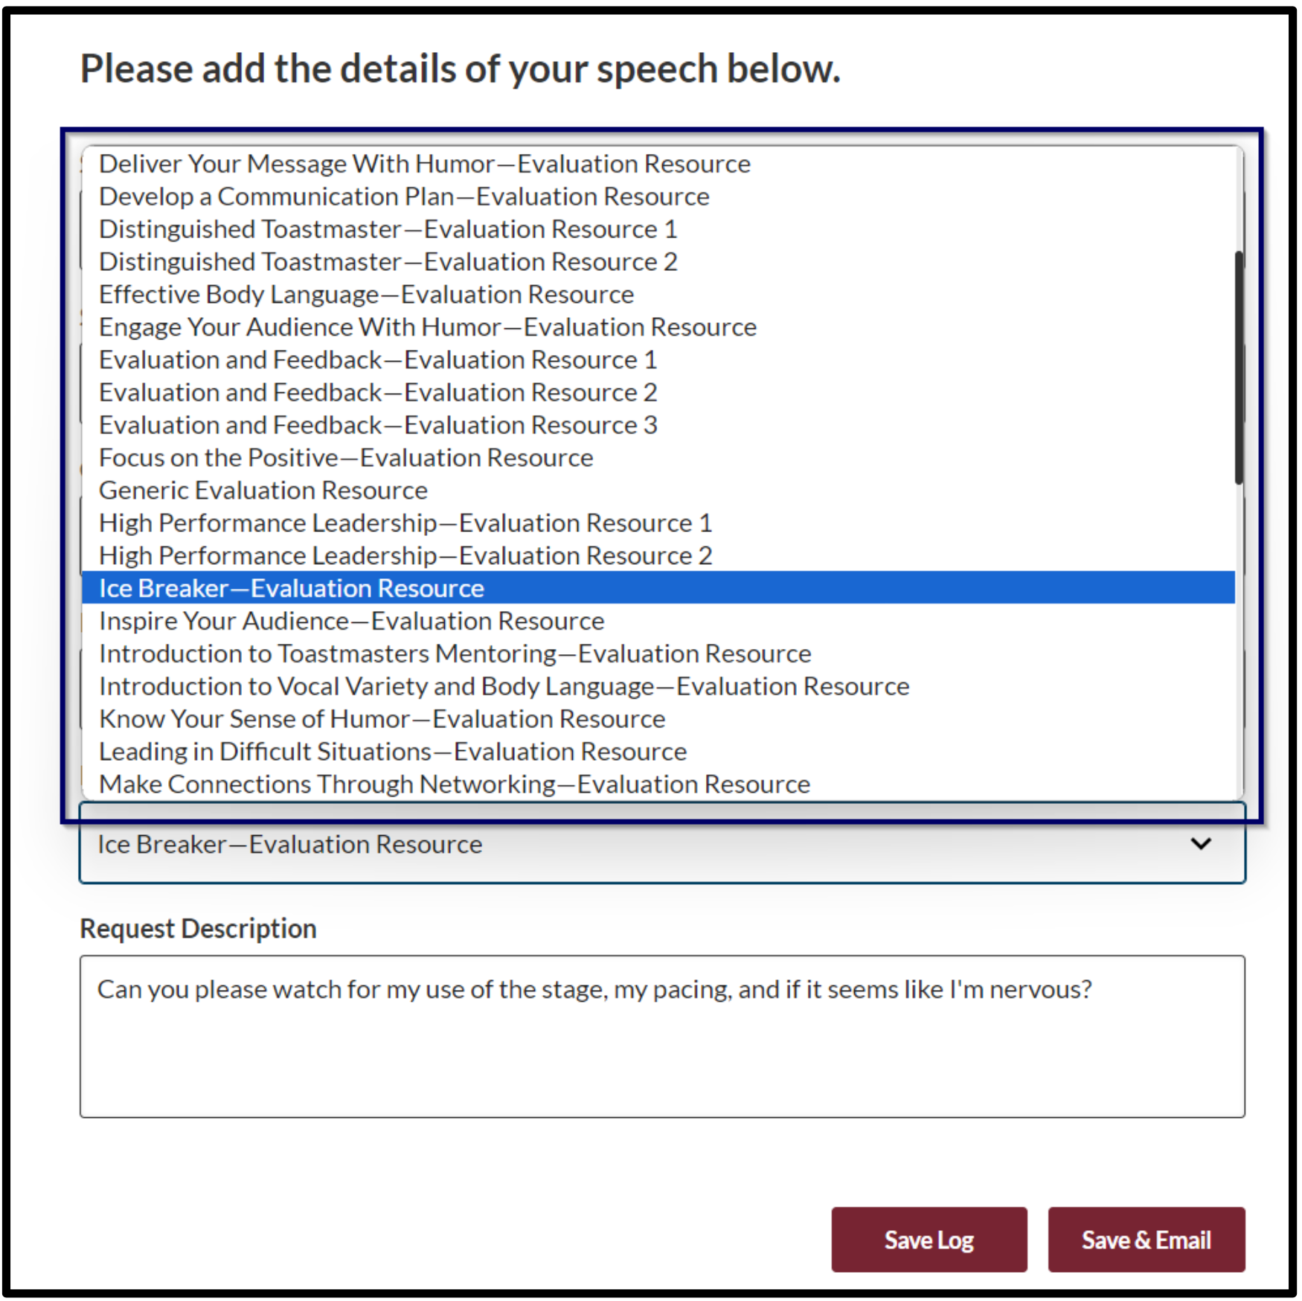
Evaluations – Requesting via Speech Log

Slide 18
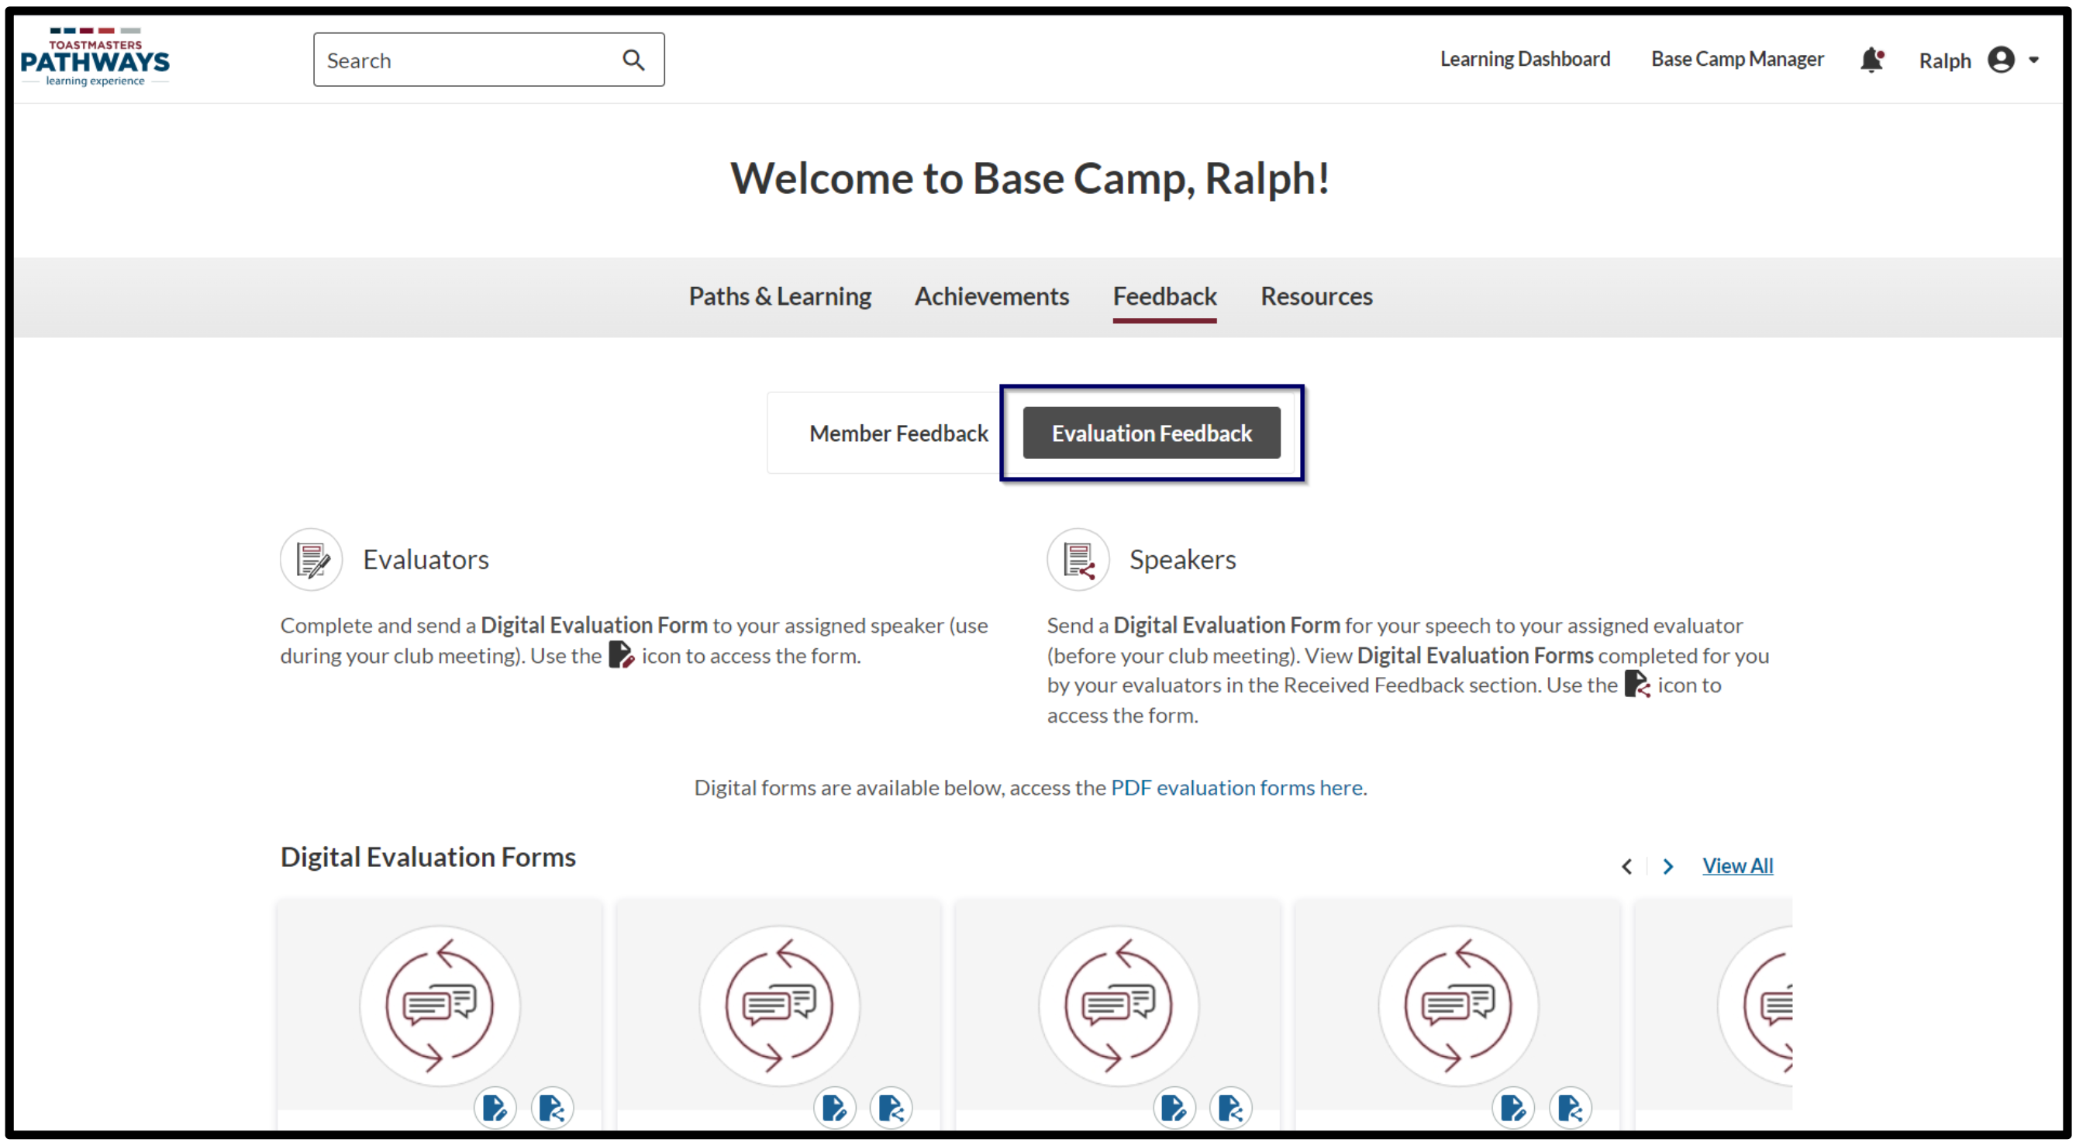
Evaluations – Requesting via Feedback Section

Slide 19
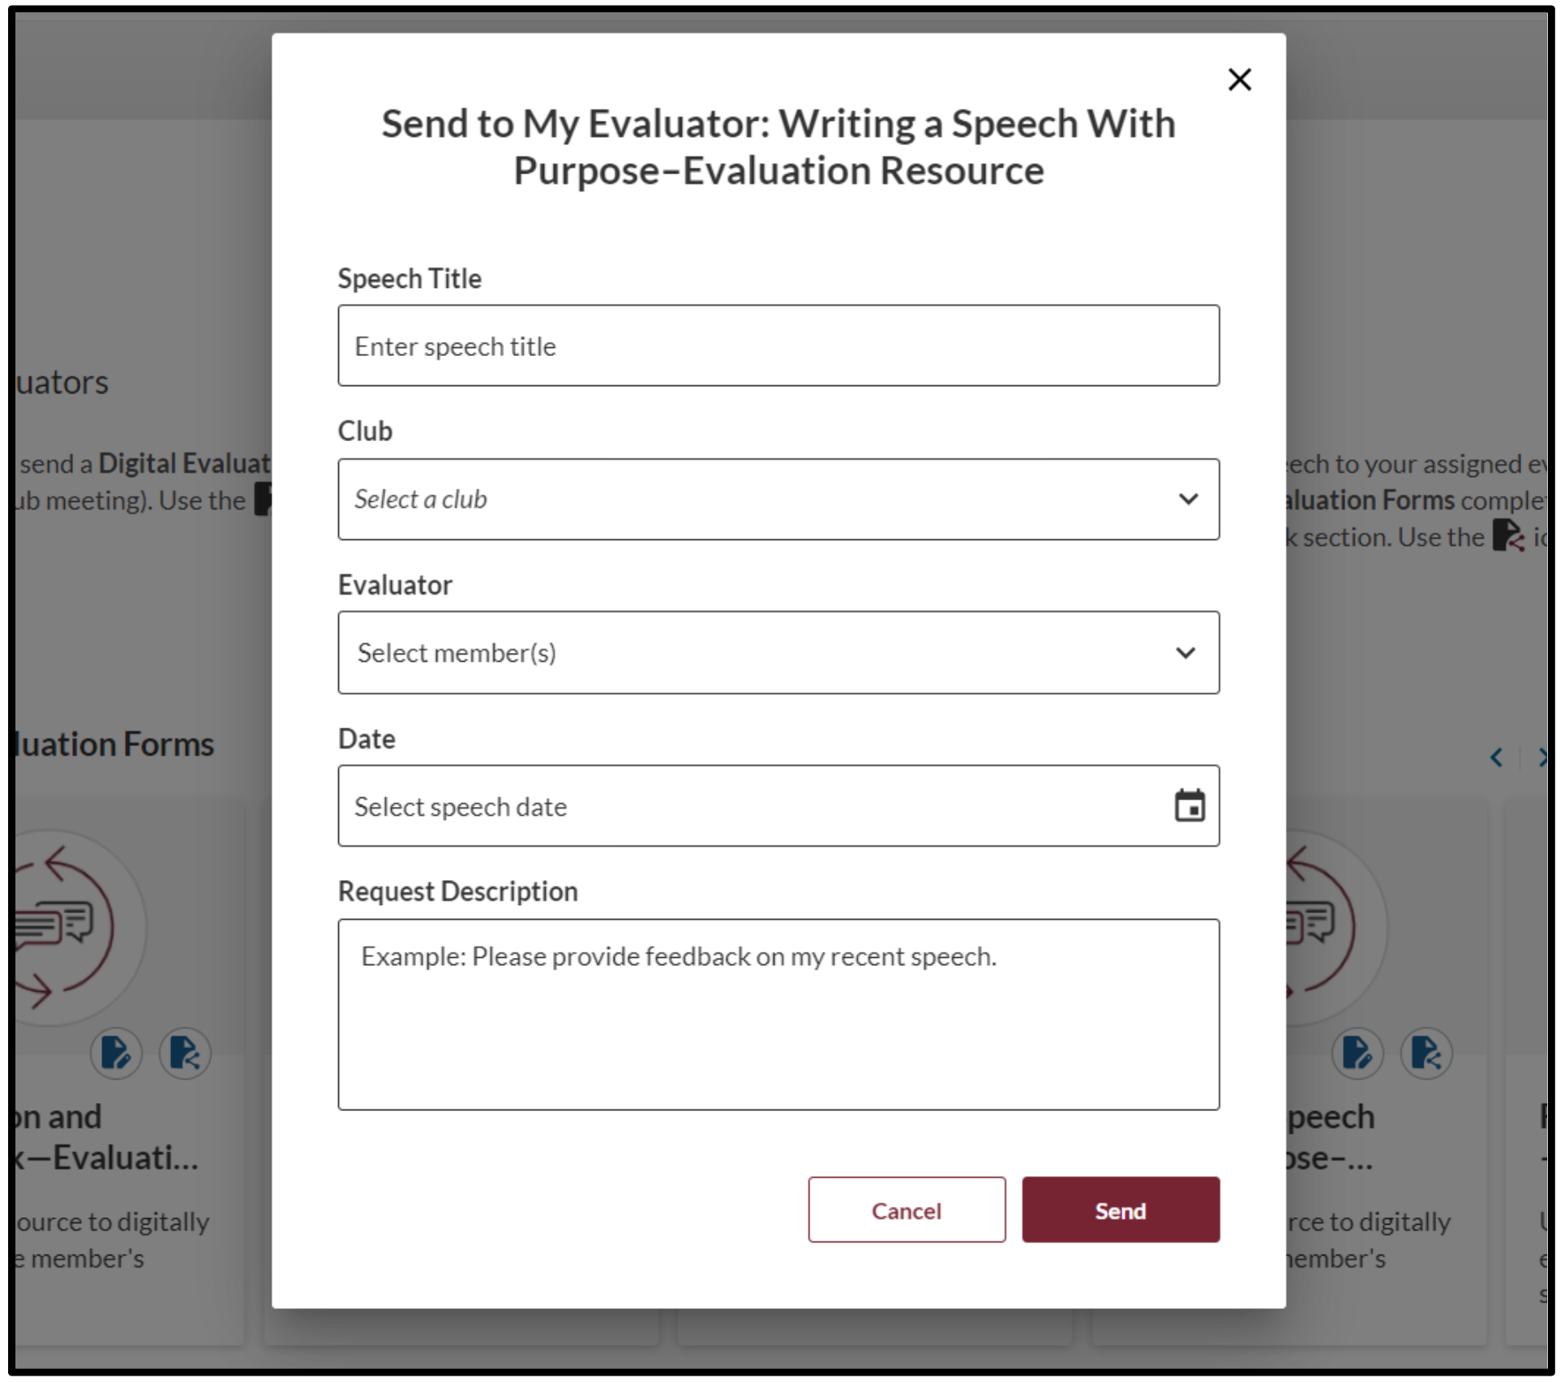
Evaluations – Requesting via Feedback Section

Slide 20
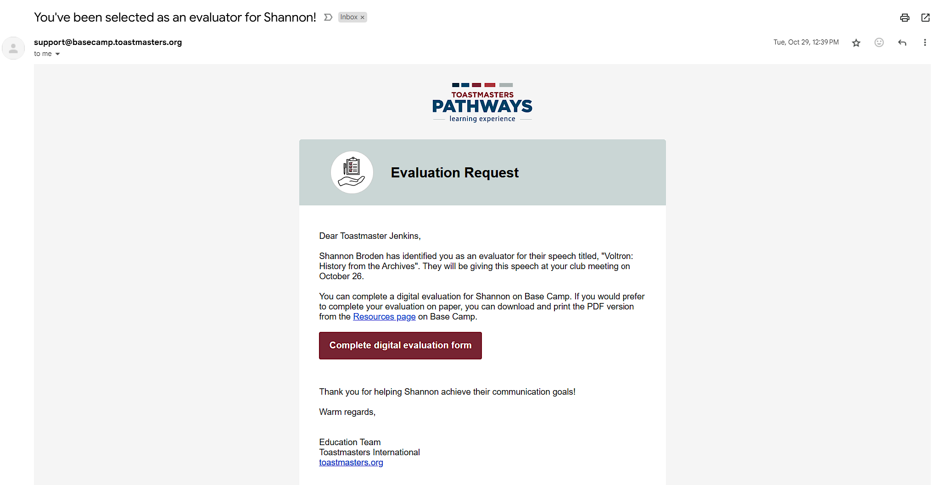
Evaluations – Request Notification Email

Slide 21
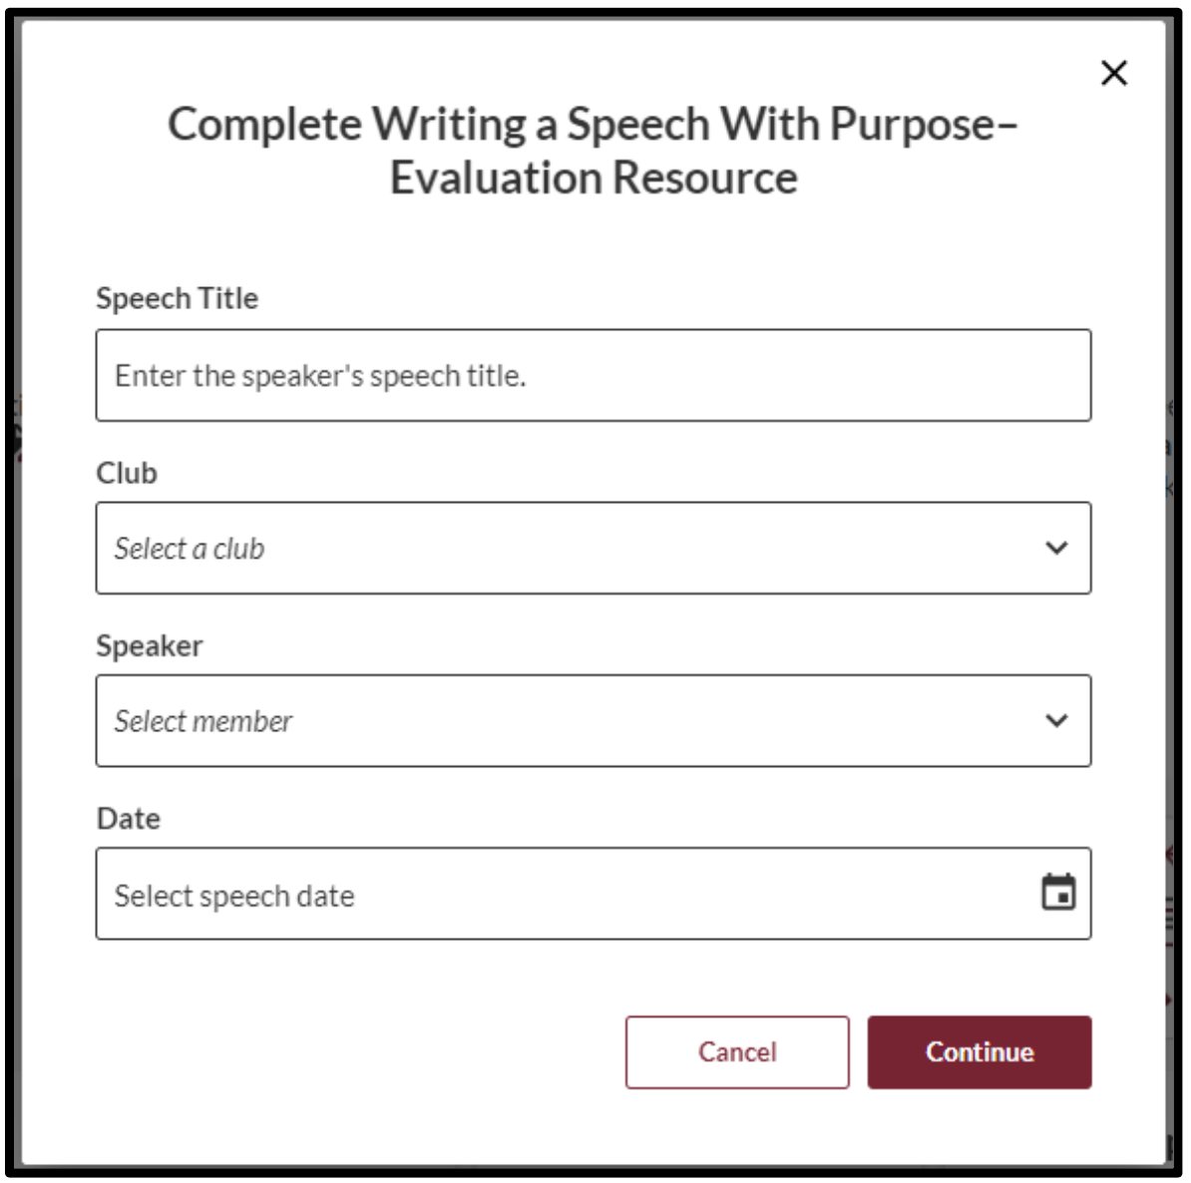
Evaluations – Providing Eval via Feedback Section

Slide 22
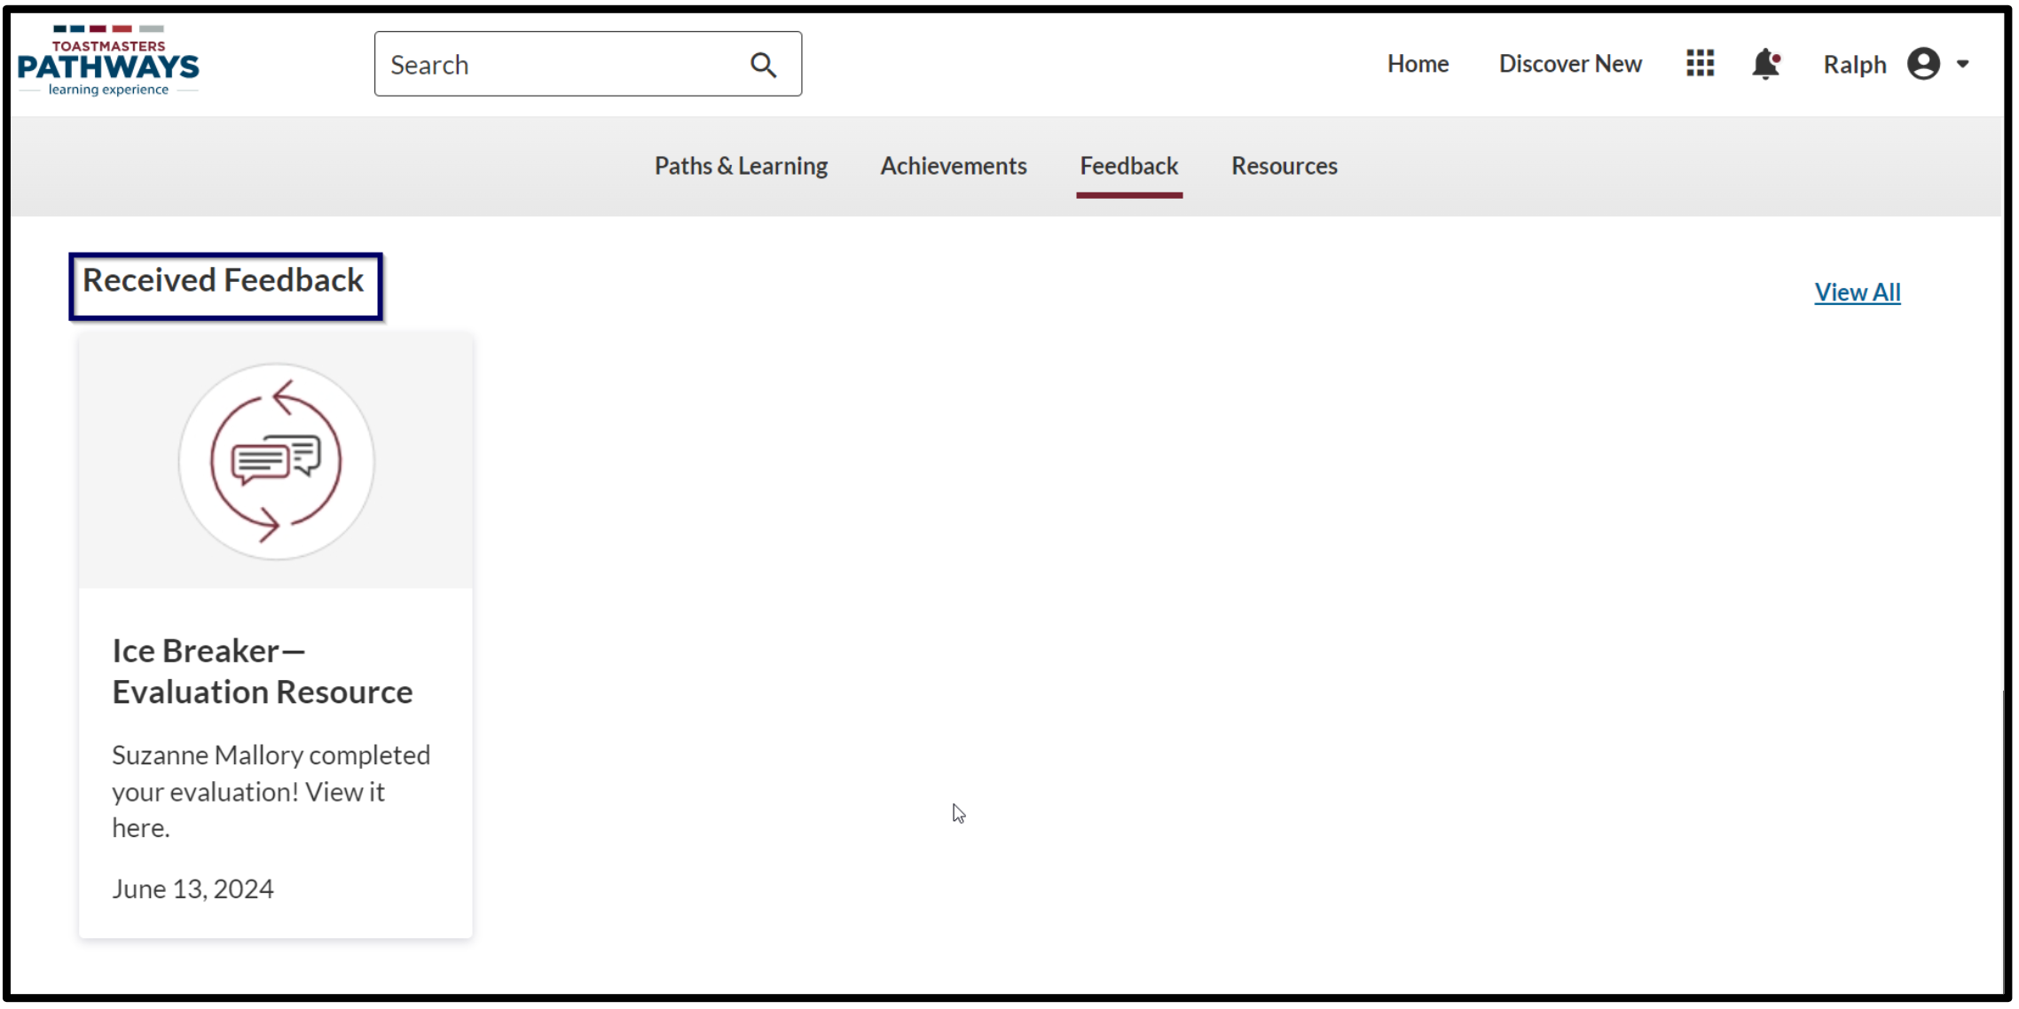
Evaluations – Receiving Feedback

Slide 23
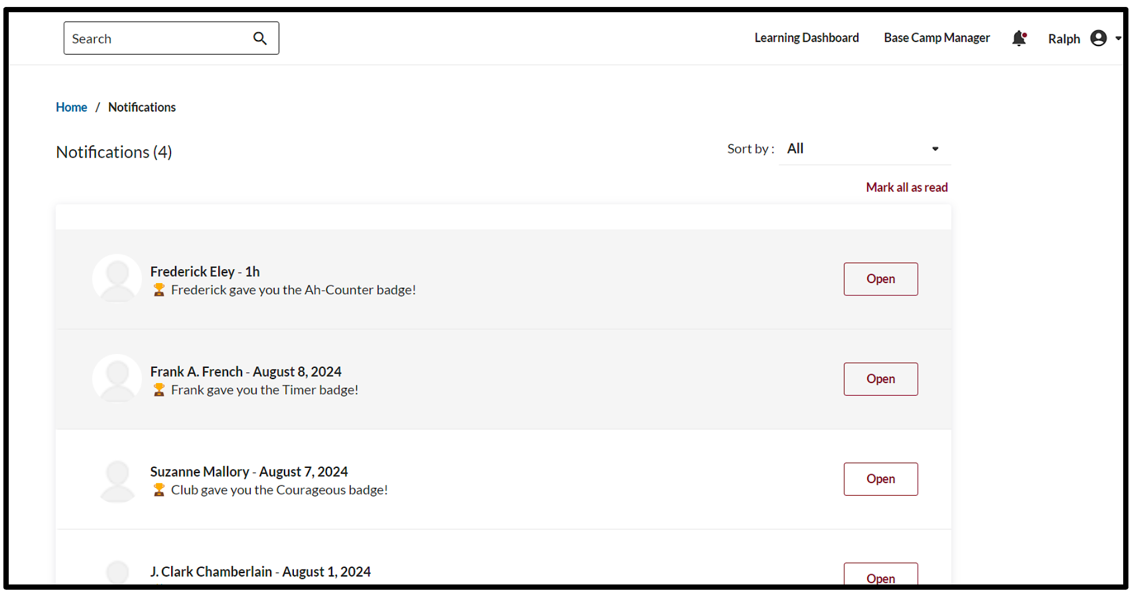
Evaluations – Receiving Feedback

Slide 24
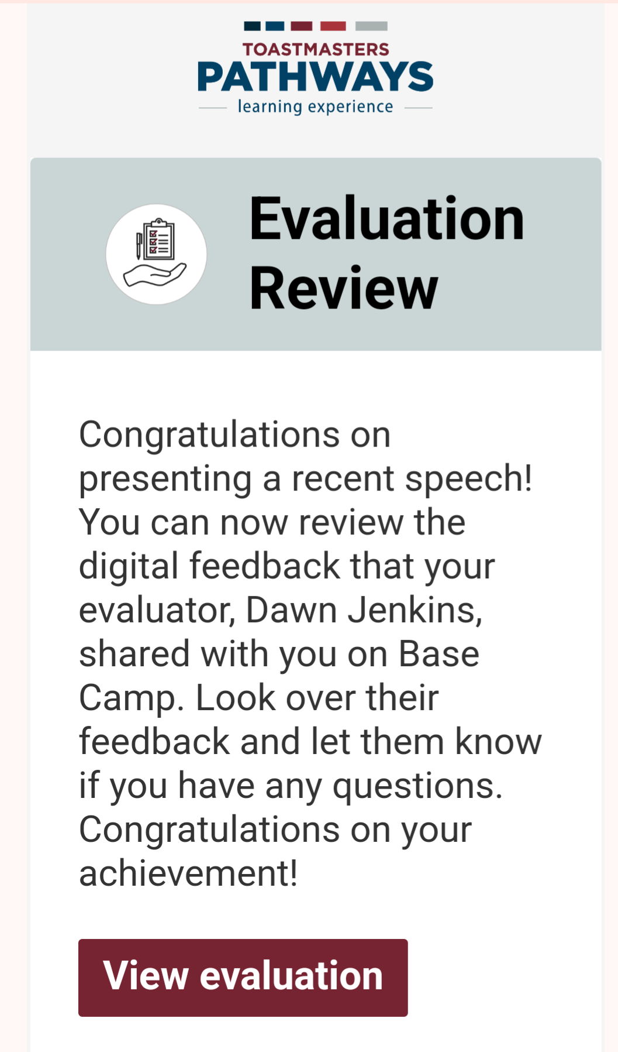
Evaluations – Receiving Feedback

Slide 25
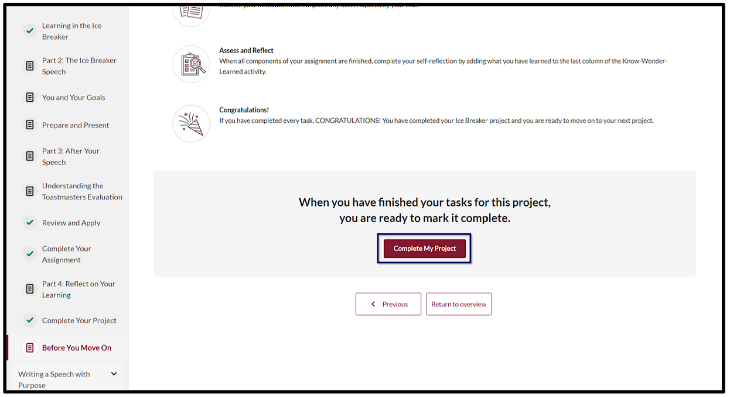
Completing a Project – Mark Complete

Slide 26
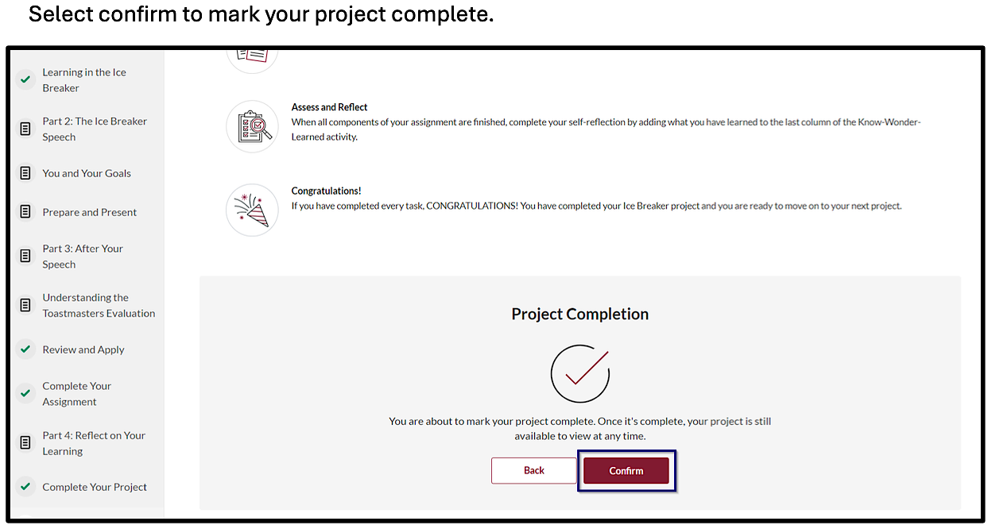
Completing a Project – Mark Complete

Slide 27
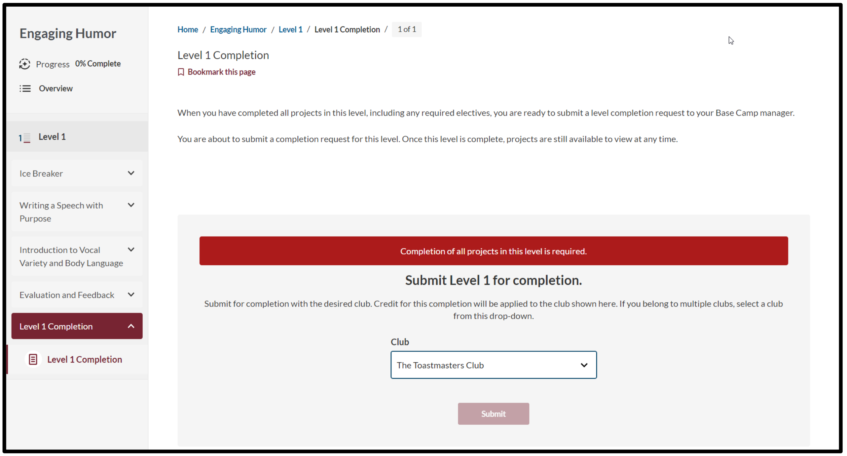
Completing a Level – Select Correct Club

Slide 28
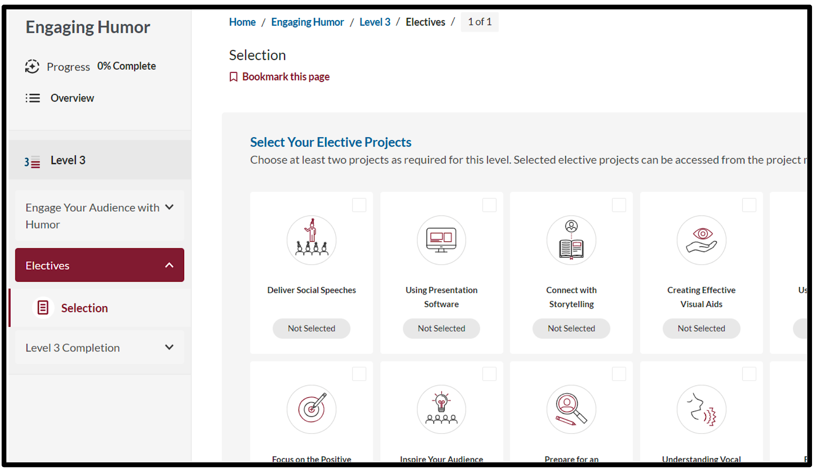
Electives – View Options

Slide 29
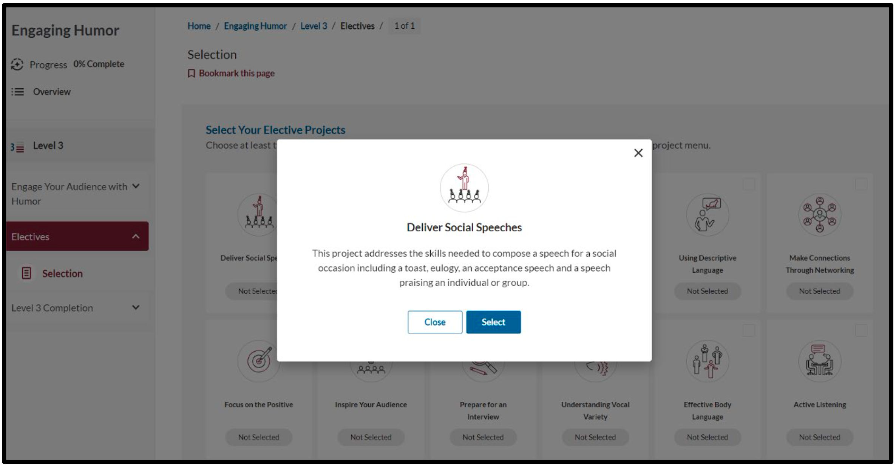
Electives – Select Desired Elective

Slide 30
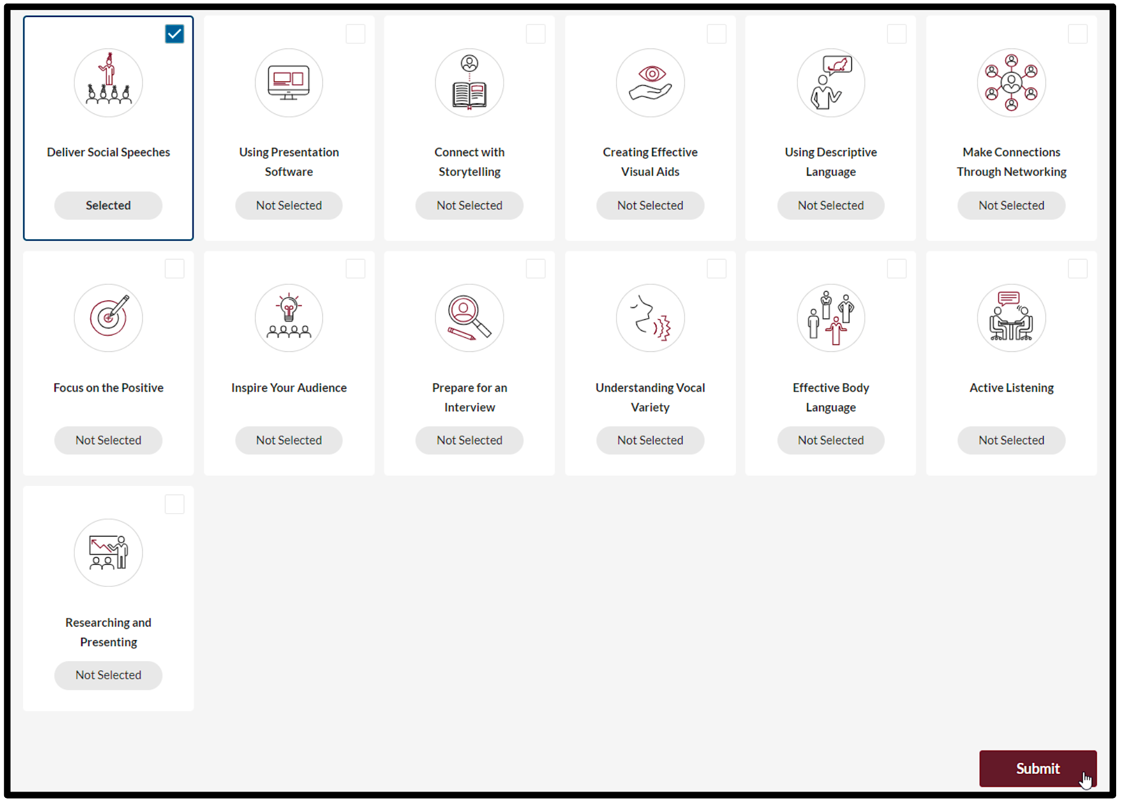
Electives – Select Desired Elective

Slide 31
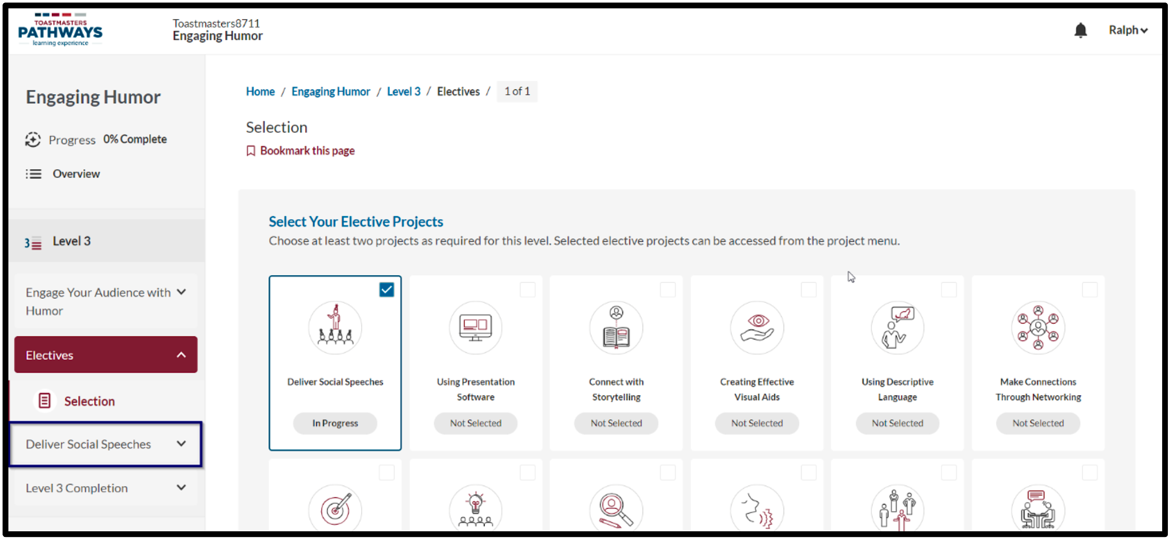
Electives – Select Desired Elective

