Slide 1
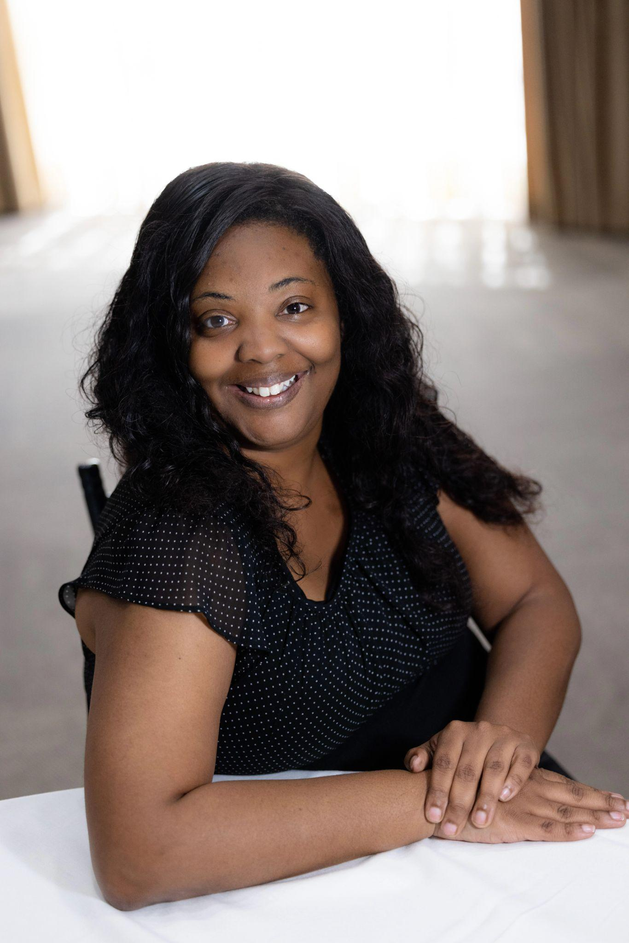
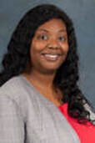
Livya Mitchell, DTM
Immediate Past District Director
District Leadership Committee Chair
Kathy Moore

Slide 2
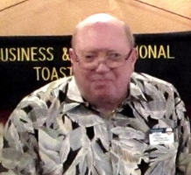
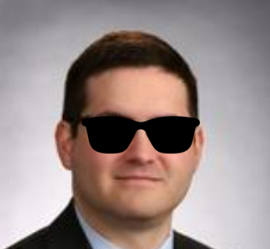
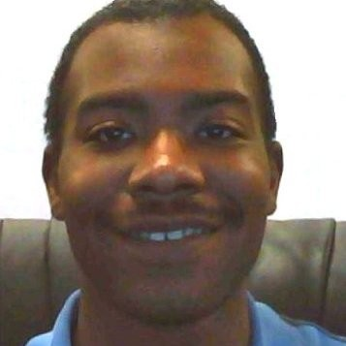
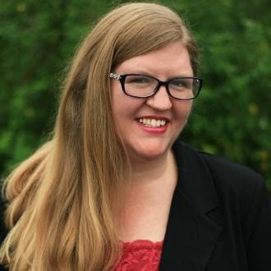
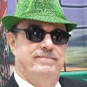
Big Thank YOU to the DLC Committee Members
Doug Kelly
Division G
Pebby Garner
Division H
Eddie Montemayor
Division I
Desmond Callaway
Division J
Melody Moore
Division K
The committee has hereby identified, certified, interviewed and nominated candidates for 4 elected positions. Since we have 1 Division K and no other, we will be conducting Division Director interviews, to fill the candidate slate.
The committee would like it to be known that we were all very impressed with the caliber of candidates we are moving forward this year. Candidates all exhibited passion for the Toastmasters Mission.
Grace Bennett served as alternate.

Slide 3
Nominees for District Director and Program Quality Director
District Director Nominee
Program Quality Director Nominee
Yiting Liu, DTM
Kevin F. Clark

Slide 4
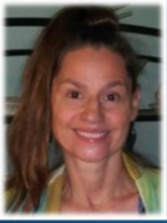
Nominees for Club Growth Director
Club Growth Director Nominee
Club Growth Director Nominee
Chris Miller
Dawn Trenholm Colvin

Slide 5
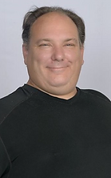
Division I, H and G Candidates
Division I Nominee
Harvey Jenkins

Slide 6
Division G, H, J and K Nominees
Division K Nominee
Division J Nominee

