Slide 1
Sam Manago
Finance Manager
Finance Manager’s Report

Slide 2
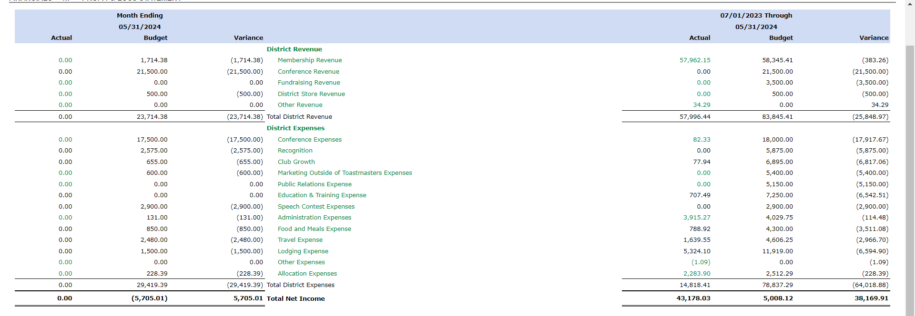
Profit & Loss

Slide 3
Balance Sheet

Slide 4
Available Funds

